Slide 1


Calculating a summary metric for complex DNA samples
Keith Inman
UVa STAT 4995
Statistical Consulting
Aug 20, 2022

Slide 2
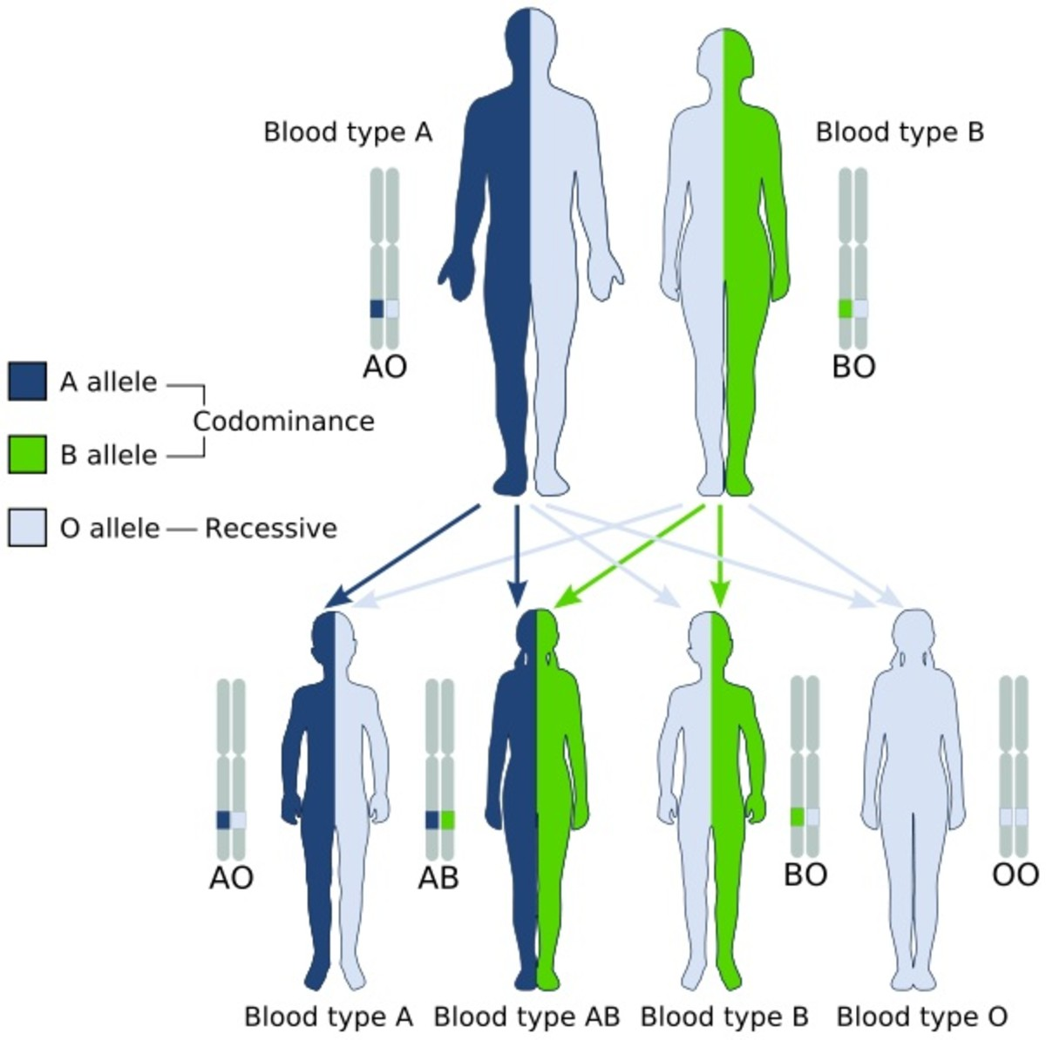

Slide 3
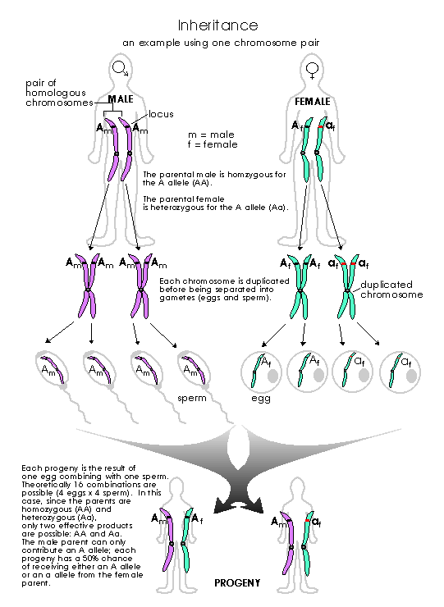

Slide 4

Current DNA typing: Short Tandem Repeats STRs
TCGGTT-GAGA-GAGA-GAGA-CCATGC
or
TCGGTT-(GAGA)₃ -CCATGC

Slide 5
STR Length Polymorphisms
Locus A: 3,5
TCGGTT - GATA- GATA - GATA- CCATGC
Type 3
TCGGTT - GATA - GATA - GATA - GATA - GATA - CCATGC
Type 5
Progeny 1
Notes:
Need some emphasis here on the inheritance of the alleles; s

Slide 6
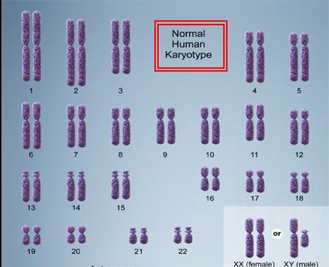
The Human Genome
46 chromosomes
23 pairs
22 pairs of autosomes
1 pair of sex chromosomes

Slide 7
Once upon a time…
STR Typing
Types at up to 23 different chromosomes
High quality single source sample

Slide 8
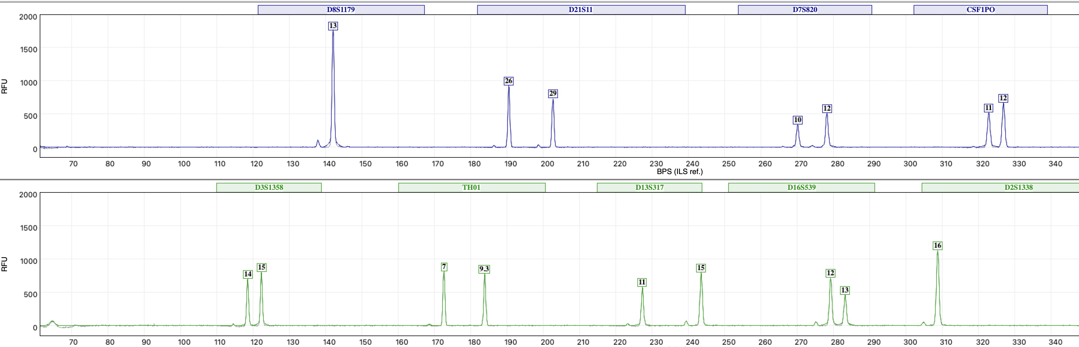
STR Typing
Types at up to 23 different chromosomes
Frequency of type:
D8 – 13,13
Occurs in 11% of pop.

Slide 9
Then we started testing everything…
Low template single source (touch DNA)

Slide 10
And the complexity increases…
Items with DNA from more than one person

Slide 11
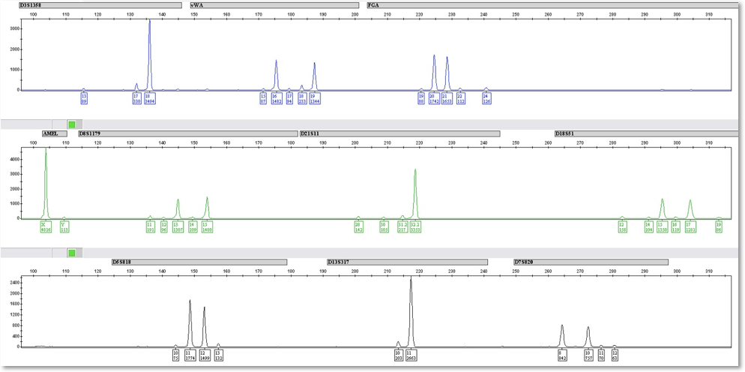
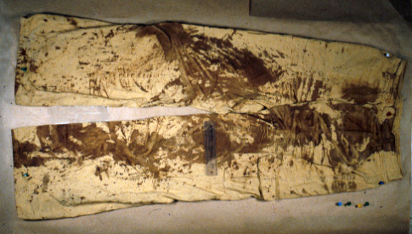
This comes into the lab…
…but this comes out

Slide 12
…and is reduced to a table of values
Marker | Allele 1 | Height 1 | Allele 2 | Height 2 | Allele 3 | Height 3 | Allele 4 | Height 4 | Allele 5 | Height 5
D8S1179 | 13 | 495 | 14 | 98 | 15 | 511
D21S11 | 28 | 262 | 30 | 299
D7S820 | 8 | 216 | 9 | 38 | 10 | 184
CSF1PO | 9 | 23 | 10 | 34 | 11 | 297
D3S1358 | 14 | 35 | 15 | 158 | 16 | 637 | 17 | 370 | 18 | 49
TH01 | 7 | 617 | 9.3 | 445
D13S317 | 11 | 260 | 12 | 138 | 13 | 240
D16S539 | 9 | 307 | 10 | 389 | 11 | 44
D2S1338 | 17 | 116 | 19 | 43 | 21 | 42 | 22 | 125
D19S433 | 13 | 155 | 14 | 476 | 15 | 363
vWA | 14 | 443 | 15 | 418 | 18 | 61
TPOX | 8 | 203 | 9 | 245 | 11 | 35
D18S51 | 15 | 200 | 18 | 156
AMEL | 1 | 518 | 2 | 463
D5S818 | 11 | 168 | 12 | 297 | 13 | 227
FGA | 24 | 163 | 25 | 185
Types from sample

Slide 13

The crucial question:
Which of these individuals, if any, could be a contributor of DNA to the evidence?

Slide 14
The current answer to this complexity
Probabilistic genotyping
Mathematical models to resolve this complexity caused by both normal life + analytical protocol
Several flavors available
Presence or absence of alleles
Pre-assessment of parameter values
Quantitative assessment of alleles
Probability density estimation of parameters
All evaluate evidence with likelihoods/likelihood ratios

Slide 15
Solutions: Mathematical models
Numerous math models published to answer this question
Use a wide variety of variables as input to calculate weight of evidence for or against any one individual
Weight of evidence in form of likelihood ratio (LR)
Run LR with two continuously variable systems (stochastic models)
likeLTD
European Forensic Mixtures (Euroformix/EFM)

Slide 16
Of the math models proposed…
No research has assessed
Which parameter contributes the most variation
Tested whether any parameter adds anything to LR
Which combination of parameters best predicts the LR
Whether a single LR communicates the proper level of uncertainty about the LR value itself
How uncertain the LR becomes (the error or range of LRs) as DNA information decreases

Slide 17
Sample
My research…
Created a set of complex mixtures
2, 3, and 4 person mixtures
Mixture ratios
1:1, 2:1, 4:1, 9:1
1:1:1, 2:2:1, 6:3:1, 8:1:1
1:1:1:1
Total DNA
500, 100, 50, 30 pg total
Highest amount of DNA in any mixture: 250 pg
Lowest amount of DNA in any mixture: 3pg (half of a diploid cell)

Slide 18
Number of samples created
Combinations of conditions = 164
Replicates = 5
Total samples = 820
Analysis of samples
Likelihood ratio (LR) calculated for each sample for each contributor
Four different PGS systems used
Only two presented for this exercise
Total sampleLRs = Many thousands

Slide 19
Expected results
Sample Detail |  |  |  |  |  |  | logLR
Sample # | Total ng | Dose Ratio | DNA major | DNA minor | DNA Major | DNA minor | likeLTD
26 | 500 | 1:1 | A | D | 250 | 250 | 10
27 | 500 | 1:1 | A | D | 250 | 250 | 9.37
28 | 500 | 1:1 | A | D | 250 | 250 | 10.6
29 | 500 | 1:1 | A | D | 250 | 250 | 8.91
30 | 500 | 1:1 | A | D | 250 | 250 | 9.93
The LRs are calculated for one set of replicates (26 - 30), using one PGS system, for one contributor
Critical variables are contained in the Table
The total logLR is the sum of each locus LR (loci are genetically independent)

Slide 20
Per-locus logLikelihood Ratios One replicate set
Locus | 26 | 27 | 28 | 29 | 30
CSF1PO | 0.63 | 0.58 | 0.64 | 0.57 | 0.62
D13S317 | 0.80 | 0.71 | 0.95 | 1.07 | 0.92
D16S539 | 0.63 | 0.49 | 0.61 | 0.90 | 0.61
D18S51 | 1.10 | 1.17 | 1.23 | 0.93 | 1.29
D19S433 | -0.03 | 0.14 | 0.17 | 0.03 | 0.00
D21S11 | 0.68 | 0.49 | 0.61 | 0.46 | 0.47
D2S1338 | 0.96 | 0.95 | 1.03 | 0.66 | 0.98
D3S1358 | 0.76 | 0.67 | 0.70 | 0.70 | 0.88
D5S818 | 0.38 | 0.31 | 0.44 | 0.38 | 0.17
D7S820 | 0.25 | -0.03 | 0.37 | -0.41 | -0.11
D8S1179 | 0.72 | 0.81 | 0.79 | 0.75 | 0.97
FGA | 1.25 | 1.34 | 1.33 | 1.06 | 1.27
TH01 | 0.55 | 0.62 | 0.52 | 0.58 | 0.65
TPOX | 0.88 | 0.64 | 0.75 | 0.79 | 0.78
WoE | 10.00 | 9.37 | 10.60 | 8.91 | 9.93

Slide 23
Representative results
Sample Detail |  |  |  |  |  |  | logLR
Sample # | Total ng | Dose Ratio | DNA major | DNA minor | DNA Major | DNA minor | EFM
401 | 30 | 2:1 | C | B | 20 | 10 | 8.33
402 | 30 | 2:1 | C | B | 20 | 10 | 6.36
403 | 30 | 2:1 | C | B | 20 | 10 | 1.97
404 | 30 | 2:1 | C | B | 20 | 10 | 4.34
405 | 30 | 2:1 | C | B | 20 | 10 | 3.73
The LRs are calculated for one set of replicates (401-405), using one PGS system, for one contributor
Critical variables are contained in the Table
The total logLR is the sum of each locus LR (loci are genetically independent)

Slide 24
Per-locus likelihood ratios One replicate set
Locus | 401 | 402 | 403 | 404 | 405
CSF1PO | 0.71 | -0.75 | -0.04 | 0.64 | 0.35
D13S317 | 2.95 | 2.90 | -0.43 | -0.71 | -0.81
D16S539 | -0.54 | 0.78 | -0.77 | 0.83 | 0.68
D18S51 | 2.14 | 1.35 | 1.14 | 1.29 | 1.24
D19S433 | 1.12 | 0.04 | 0.79 | 0.76 | 0.11
D21S11 | 3.63 | 1.84 | -0.30 | 3.93 | 3.46
D2S1338 | 2.12 | 3.01 | 1.86 | 2.39 | 2.23
D3S1358 | 2.02 | 1.74 | 1.69 | 1.60 | 0.08
D5S818 | 0.26 | 0.05 | 0.07 | -1.17 | 0.34
D7S820 | 1.26 | 0.98 | -0.13 | 1.30 | 0.20
D8S1179 | 0.95 | 0.79 | 0.36 | 0.72 | 0.77
FGA | -0.59 | -0.91 | -0.32 | -1.22 | -1.18
TH01 | 0.85 | 0.52 | 0.62 | 0.00 | 0.50
TPOX | 2.11 | 1.27 | -0.11 | -0.51 | -0.36
WoE | 8.33 | 6.36 | 1.97 | 4.34 | 3.73

Slide 27
My request…
Create a method to determine which parameter contributes the most variation
Total DNA
Number of contributors
Dose/Ratio of true contributor (TC)
Stutter present or absent
Replicates
per Locus LRs
Math model
* Note to class: frequency not to be considered (insufficient data)

Slide 28
Tangential:
I will have hundreds of these replicate analyses
Is there a single metric that will summarize the variation exhibited by one replicate set to demonstrate the differences between all of the replicate sets.

Slide 30
Data for your use…
Datafile with all results
R markdown file (.Rmd) or R script for your use
To run any replicate set you wish (5 at time).

